Slide 1
How well do you resist stress?

Slide 2
Rating System
4 = Always
3 = Almost Always
2 = Most of the time
1 = Some of the time
0 = Never

Slide 3
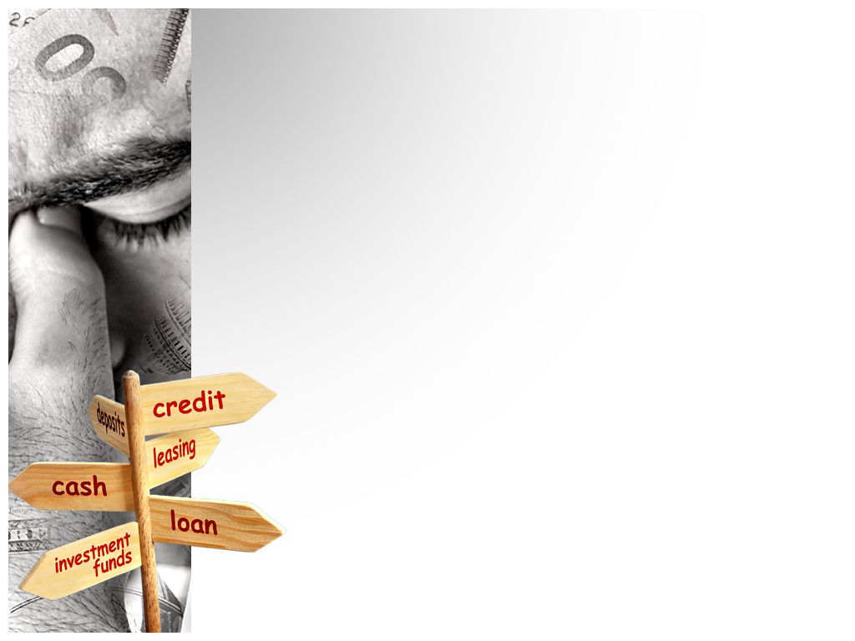
1. During most of my life I…
Eat at least two full, balanced meals a day.
4 = Always
3 = Almost Always
2 = Most of the time
1 = Some of the time
0 = Never

Slide 4
2. During most of my life I…
Get seven to eight hours’ of sleep.
4 = Always
3 = Almost Always
2 = Most of the time
1 = Some of the time
0 = Never

Slide 5
3. During most of my life I…
Give and receive affection regularly.
4 = Always
3 = Almost Always
2 = Most of the time
1 = Some of the time
0 = Never

Slide 6
4. During most of my life I…
Have at least one relative that I can rely on.
4 = Always
3 = Almost Always
2 = Most of the time
1 = Some of the time
0 = Never

Slide 7
5. During most of my life I…
Exercise to the point of perspiration at least twice per week.
4 = Always
3 = Almost Always
2 = Most of the time
1 = Some of the time
0 = Never

Slide 8
6. During most of my life I…
Avoid tobacco or smoke less than half a pack of cigarettes or half a tin of chew a day.
4 = Always
3 = Almost Always
2 = Most of the time
1 = Some of the time
0 = Never

Slide 9
7. During most of my life I…
Avoid drugs and alcohol
4 = Always
3 = Almost Always
2 = Most of the time
1 = Some of the time
0 = Never

Slide 10
8. During most of my life I…
Am at an appropriate weight for my height.
4 = Always
3 = Almost Always
2 = Most of the time
1 = Some of the time
0 = Never

Slide 11
9. During most of my life I…
Feel that my basic needs are being met.
4 = Always
3 = Almost Always
2 = Most of the time
1 = Some of the time
0 = Never

Slide 12
10. During most of my life I…
Get strength from my values and beliefs.
4 = Always
3 = Almost Always
2 = Most of the time
1 = Some of the time
0 = Never

Slide 13
11. During most of my life I…
Regularly attend groups or social activities.
4 = Always
3 = Almost Always
2 = Most of the time
1 = Some of the time
0 = Never

Slide 14
12. During most of my life I…
Have a network of friends.
4 = Always
3 = Almost Always
2 = Most of the time
1 = Some of the time
0 = Never

Slide 15
13. During most of my life I…
Have one or more friends to share personal information with.
4 = Always
3 = Almost Always
2 = Most of the time
1 = Some of the time
0 = Never

Slide 16
14. During most of my life I…
Am in good physical health (including eyesight, hearing, and teeth).
4 = Always
3 = Almost Always
2 = Most of the time
1 = Some of the time
0 = Never

Slide 17
15. During most of my life I…
Am able to speak openly about my feelings when angry or worried.
4 = Always
3 = Almost Always
2 = Most of the time
1 = Some of the time
0 = Never

Slide 18
16. During most of my life I…
Have regular conversations with the people I live with about issues around the house
(ex. chores or curfew).
4 = Always
3 = Almost Always
2 = Most of the time
1 = Some of the time
0 = Never

Slide 19
17. During most of my life I…
Have some fun each day.
4 = Always
3 = Almost Always
2 = Most of the time
1 = Some of the time
0 = Never

Slide 20
18. During most of my life I…
Organize my time effectively.
4 = Always
3 = Almost Always
2 = Most of the time
1 = Some of the time
0 = Never

Slide 21
19. During most of my life I…
Drink two or less cups of caffeinated beverages per day (ex. Coffee, Pop, Tea, Energy drinks).
4 = Always
3 = Almost Always
2 = Most of the time
1 = Some of the time
0 = Never

Slide 22
20. During most of my life I…
Take quiet time for myself each day.
4 = Always
3 = Almost Always
2 = Most of the time
1 = Some of the time
0 = Never

Slide 23
21. During stressful times I…
Organize my responsibilities and meet the most important ones first.
4 = Always
3 = Almost Always
2 = Most of the time
1 = Some of the time
0 = Never

Slide 24
22. During most of my life I…
Refuse to take on too many responsibilities.
4 = Always
3 = Almost Always
2 = Most of the time
1 = Some of the time
0 = Never

Slide 25
23. During most of my life I…
Express my feelings as needed
4 = Always
3 = Almost Always
2 = Most of the time
1 = Some of the time
0 = Never

Slide 26
24. During most of my life I…
Practice relaxation techniques.
4 = Always
3 = Almost Always
2 = Most of the time
1 = Some of the time
0 = Never

Slide 27
25. During most of my life I…
Seek outside help if needed.
4 = Always
3 = Almost Always
2 = Most of the time
1 = Some of the time
0 = Never

Slide 28
Scoring
81-100 Congratulations your defenses against daily stress is strong !
61-80 You are well defended against stress, but you could improve your defenses
41-60 You are too vulnerable to stress, try to improve and find ways to manage or eliminate some stresses in your life.
0-40 You urgently need strategies for handling stress.

